Slide 1
Cluster ALGORITHM
PHY 256 Computational Physics Final Project
Alternative algorithm for the Ising model Monte Carlo Simulation

Slide 2
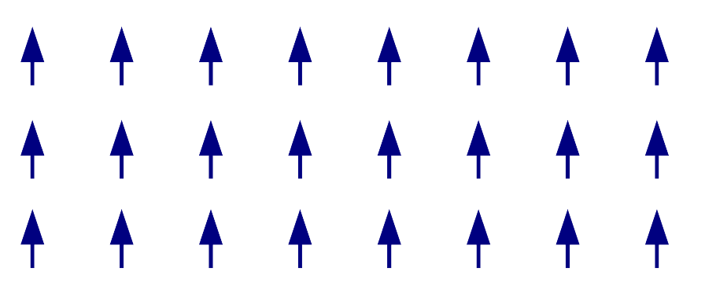
Theory of Magnetism
A key ingredient in the theory of magnetism is the electron's spin and the associated magnetic moment.
Ferromagnetism arises when a collection of such spins conspire so that all of their magnetic moment point in the same direction, yielding a total moment that is macroscopic in size.

Slide 3
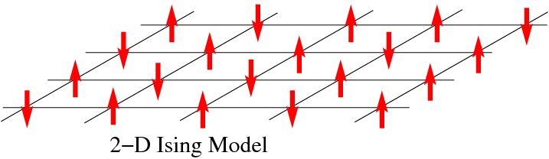
Ising Model (1920s)
We also noticed that systems generally lose their magnetism at high temperatures (phase transition at Tc).
We would like to understand why and how the magnetic properties depend on temperature.

Slide 4
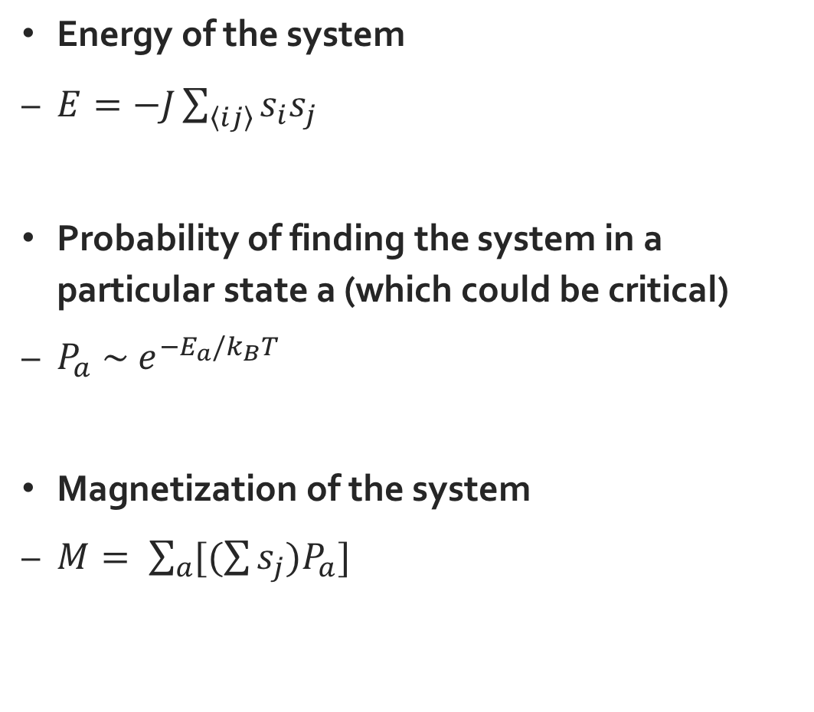
Ising Model (1920s)
Energy of the system
$E=−J\sum_{\left\langle ij\right\rangle }{s_{i}s_{j}}$
Probability of finding the system in a particular state a (which could be critical)
$P_{a} \sim e^{−E_{a}/k_{B}T}$
Magnetization of the system
$M= \sum_{a}{[(\sum{s_{j}{)P}_{a}}]}$

Slide 5
Monte Carlo Simulation
Monte Carlo Method
Metropolis Algorithm (1953)
Swendsen-Wang Algorithm (1987)
Wolff Algorithm (1989)
The Metropolis algorithm works very well in simulating the properties of the 2-D Ising model.
However, close to the Curie temperature Tc, the simulations suffer from critical slowing down, and more efficient algorithms are needed.

Slide 6
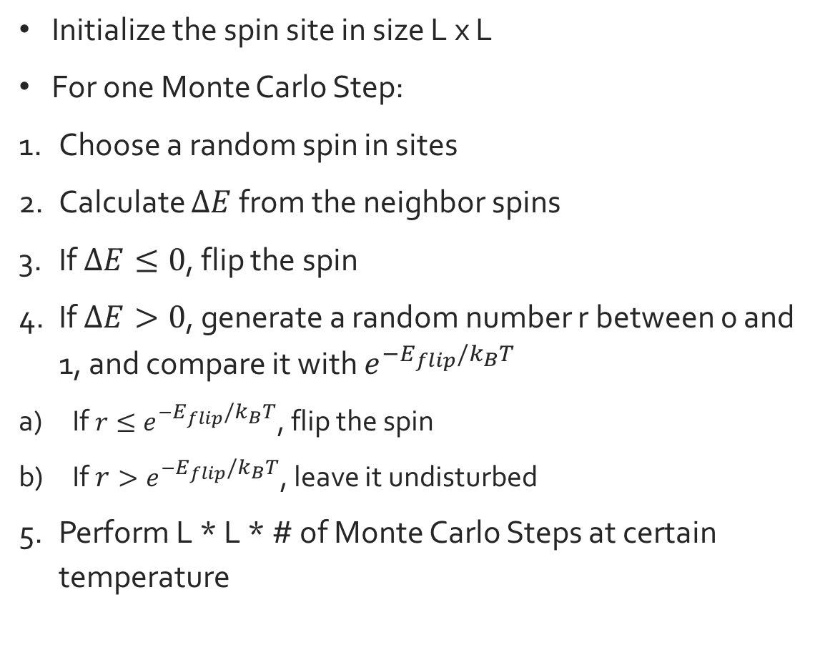
Metropolis Algorithm (Local)
Initialize the spin site in size L x L
For one Monte Carlo Step:
Choose a random spin in sites
Calculate $∆E$ from the neighbor spins
If $∆E≤0$, flip the spin
If $∆E>0$, generate a random number r between 0 and 1, and compare it with $e^{−E_{flip}/k_{B}T}$
If $r≤e^{−E_{flip}/k_{B}T}$, flip the spin
If $r>e^{−E_{flip}/k_{B}T}$, leave it undisturbed
Perform L * L * # of Monte Carlo Steps at certain temperature

Slide 7

Metropolis Algorithm (Local)
Thermalization Cycle
Measurement Cycle across a temperature range
At each temperature:
Mean Energy $\left\langle E\right\rangle$
Magnetization $M= \sum{s_{j}}$

Slide 8
Wolff Algorithm (Non-local)
Initialize the spin site in size L x L
For one Monte Carlo Step:
Choose a random spin as the seed spin
Mark it a part of the cluster
Grow a cluster from the seed spin by checking each of its 4 neighbor
If the neighbor is marked as a cluster spin, continue with the next neighbor, or quit if 4 neighbors are marked. Otherwise:

Slide 9
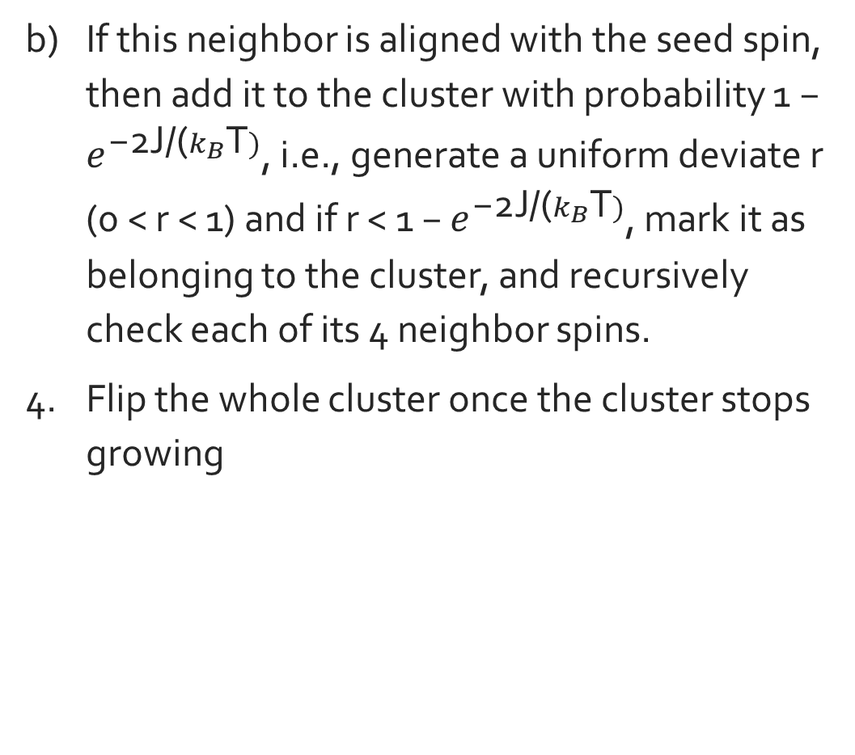
Wolff Algorithm (Non-local)
If this neighbor is aligned with the seed spin, then add it to the cluster with probability 1 − $e^{\text{−2}\text{J}\text{/(}k_{B}\text{T})}$, i.e., generate a uniform deviate r (0 < r < 1) and if r < 1 − $e^{\text{−2}\text{J}\text{/(}k_{B}\text{T})}$, mark it as belonging to the cluster, and recursively check each of its 4 neighbor spins.
Flip the whole cluster once the cluster stops growing

Slide 10
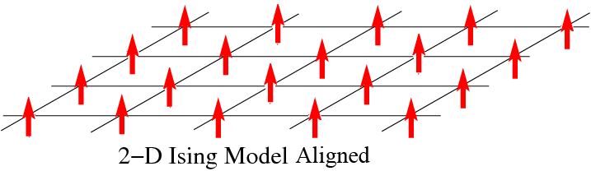
For 1 MC step at low temperature (below 2K)

Slide 11
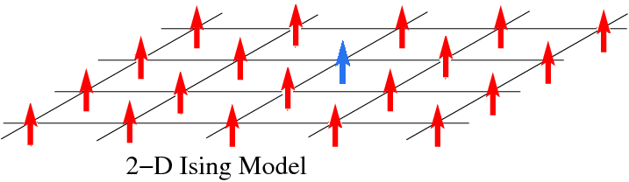
Choose a seed spin randomly

Slide 12
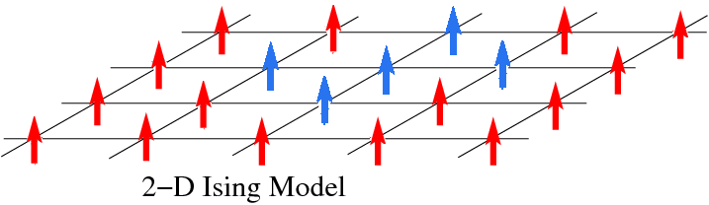
Grow a cluster

Slide 13
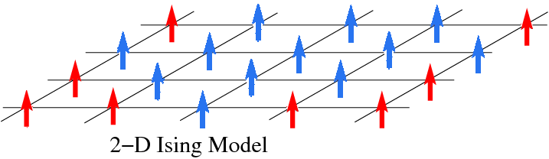
Cluster continue growing

Slide 14
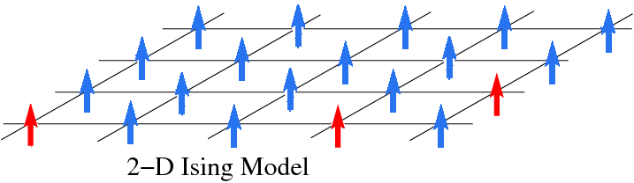
Cluster stops growing

Slide 15
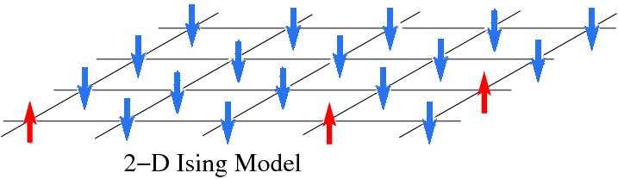
Flipped the cluster

Slide 16
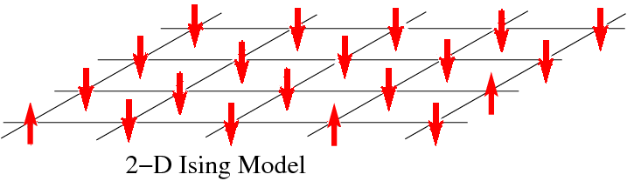
Reset spin site and repeat the process

Slide 17
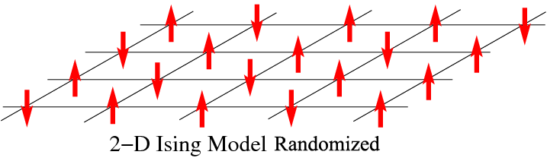
For 1 MC step at high temperature (above 2K)

Slide 18
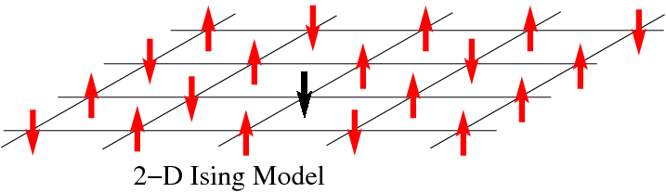
Choose a seed spin randomly

Slide 19
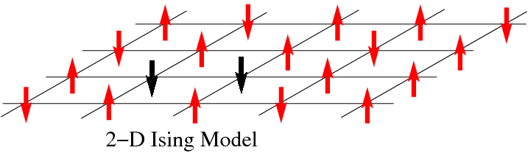
Grow a cluster

Slide 20

Flip the cluster

Slide 21
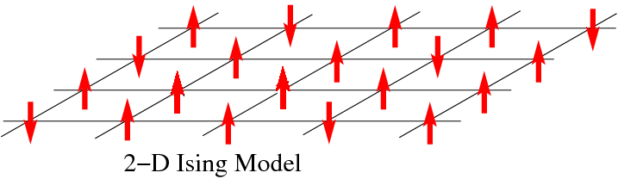
Reset spin site and repeat the process

Slide 22
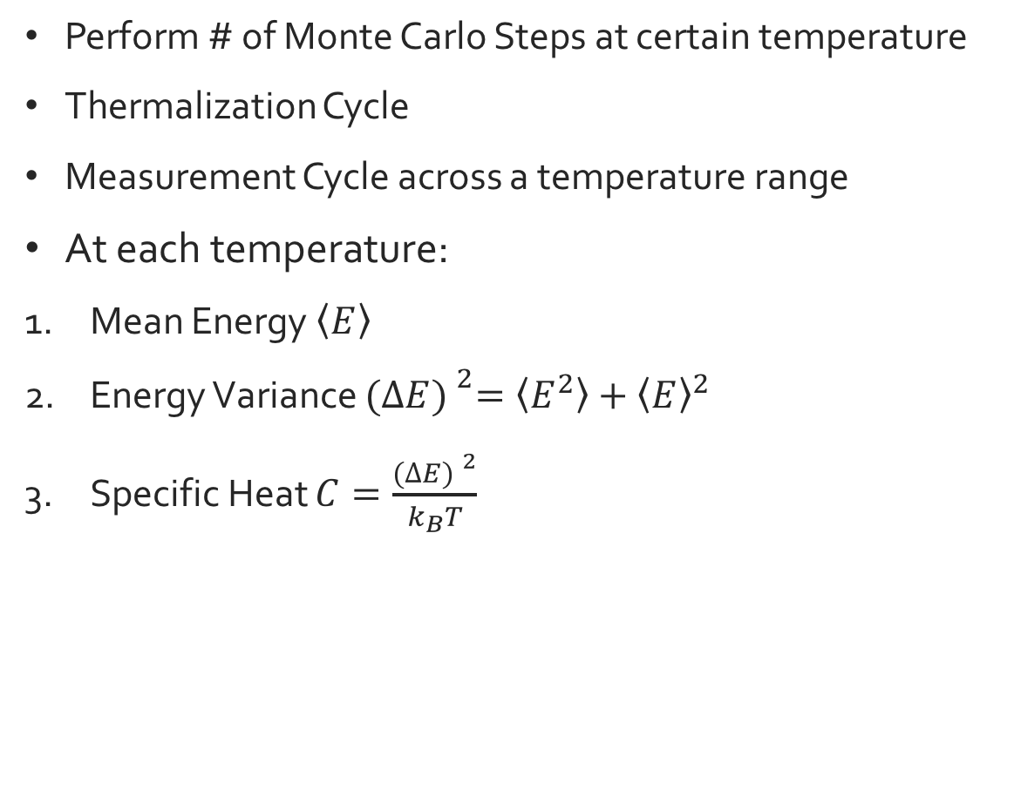
Wolff Algorithm
Perform # of Monte Carlo Steps at certain temperature
Thermalization Cycle
Measurement Cycle across a temperature range
At each temperature:
Mean Energy $\left\langle E\right\rangle$
Energy Variance ${(∆E) }^{2}=\left\langle E^{2}\right\rangle +{\left\langle E\right\rangle }^{2}$
Specific Heat $C=\frac{{(∆E) }^{2}}{k_{B}T}$

Slide 23
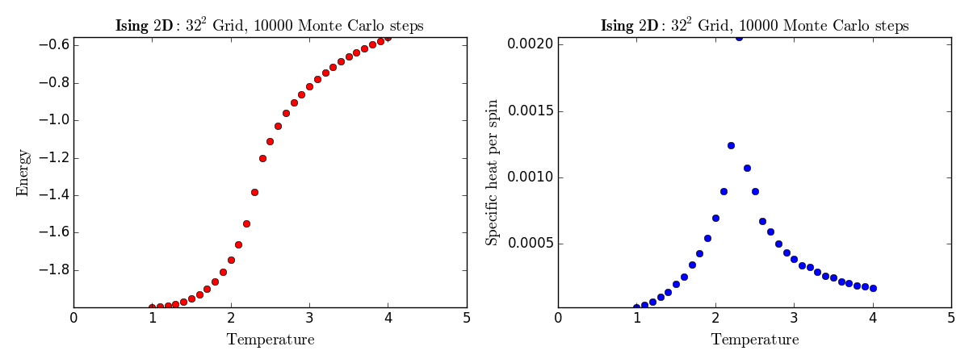
Metropolis Algorithm

Slide 24
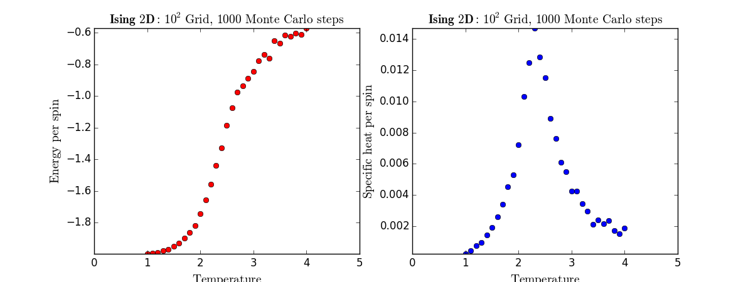
Wolff Algorithm

Slide 25
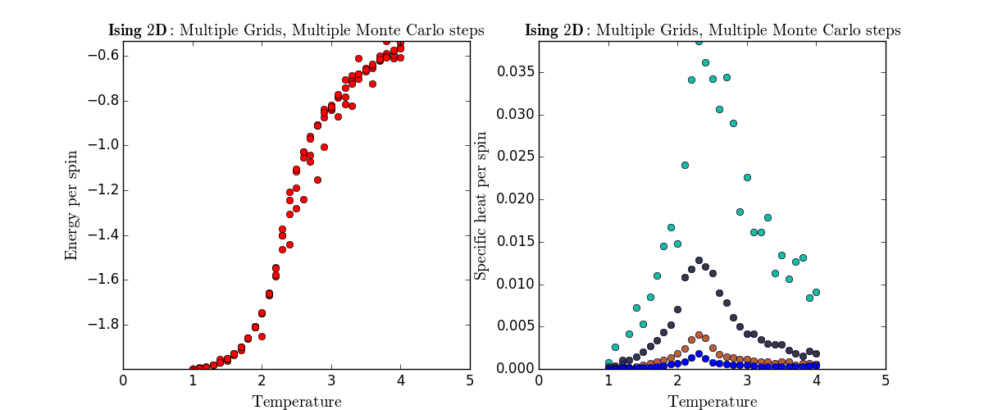

Wolff Algorithm
Tc $≈$ 2.27
L = 32
L = 20
L = 10
L = 5

Slide 26
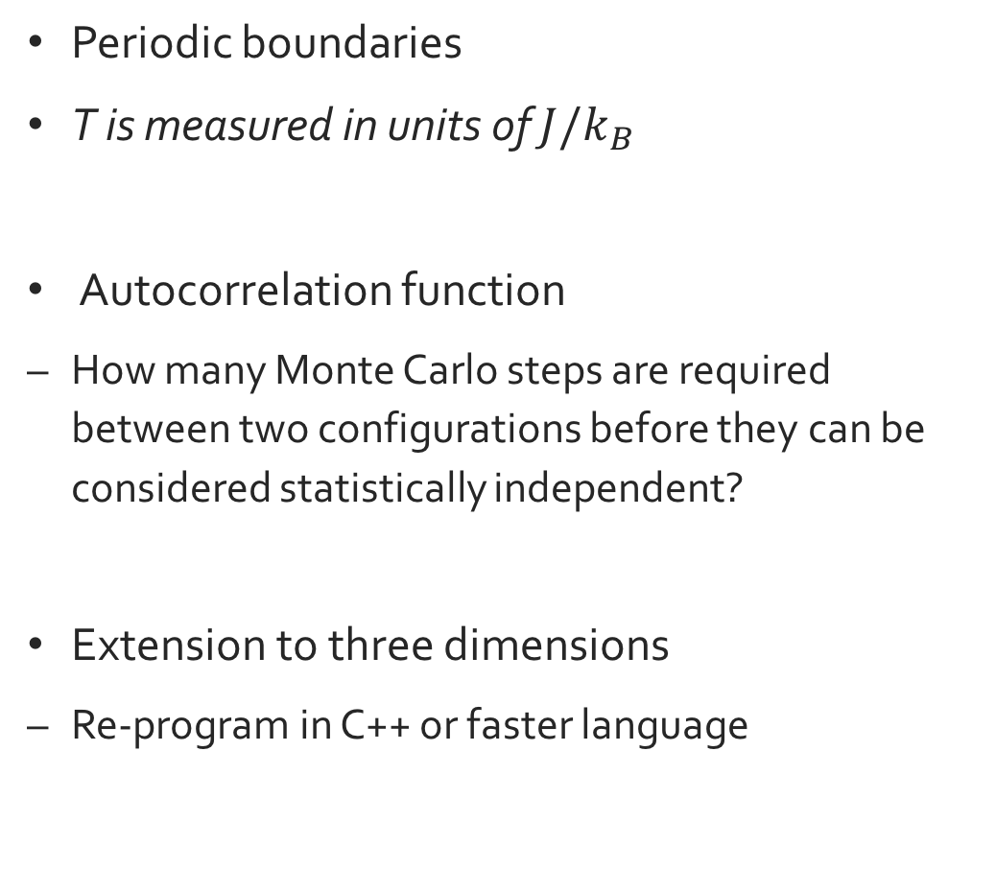
Critical Assumptions & Further Studies
Periodic boundaries
T is measured in units of $J/k_{B}$
Autocorrelation function
How many Monte Carlo steps are required between two configurations before they can be considered statistically independent?
Extension to three dimensions
Re-program in C++ or faster language

Slide 27
References
Giordano, N. (2005). Statistical Mechanics, Phase Transitions, and the Ising Model. In Computational physics (2nd ed.). Upper Saddle River, New Jersey: Prentice Hall.
Code for the Wolff cluster algorithm. (2014, March 25). Retrieved April 26, 2015, from http://www.physics.buffalo.edu/phy411-506-2004/Topic3/topic3-lec7.pdf
Sandvik,, A. (2013, October 22). Monte Carlo simulations in classical statistical physics. Retrieved April 26, 2015, from http://physics.bu.edu/py502/lectures5/mc.pdf
Critical Slowing Down and Cluster Algorithms. (2014, March 25). Retrieved April 29, 2015, from http://www.physics.buffalo.edu/phy410-505-2009/topic6/lec-6-3.pdf
© Zunran Guo ‘17

